Slide 1


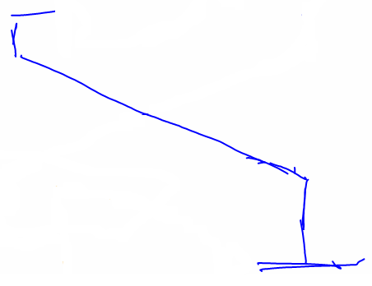
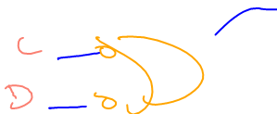

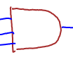
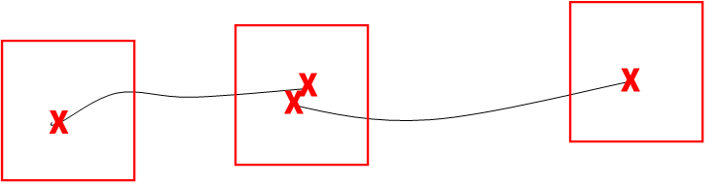

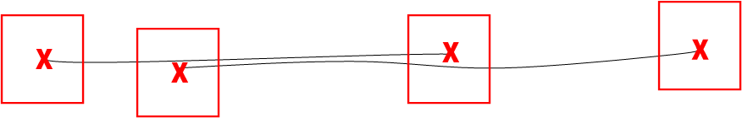
Sketch-Based Tool for Digital Circuit Recognition:
Circuit Parsing
Matthew Weiner, Christine Alvarado, Sarah Harris
Background. Traditional mouse-and-keyboard-based computer aided design tools can be cumbersome to use. The Sketchers Research Group aims to build a complete sketch recognition system to provide a more natural procession from circuit design to simulation.
Problem Overview. One part of the recognition system is the circuit parser, which interprets a sketch in the context of the digital domain. This consists of connecting the previously recognized circuit elements and assigning a polarity to each wire. Overstroking of wires, gaps between gates and wires, and varying numbers of connections to gates complicate the connection phase. Also, user drawings of input, output, and internal signals differ from sketch to sketch, making the assignment of a polarity to each wire difficult.
Circuit Parsing. Steps of circuit parsing: 1) Determine wire endpoints near gates, labels or other wires using an iterative, multi-stage algorithm. Both stages aim to combine strokes. The first stage combines two strokes if the endpoints are near each other and the slopes are similar. The second stage combines strokes if the endpoint is close to another stroke.
Overstroked
Gap
Two Input
Three Input
Challenges to circuit parsing. Top-Left: overstroked wire. Top-Right: gap in sketch. Bottom: non-uniform symbols.
Finding Endpoints. Top: stage one. Bottom: stage two.

Slide 2
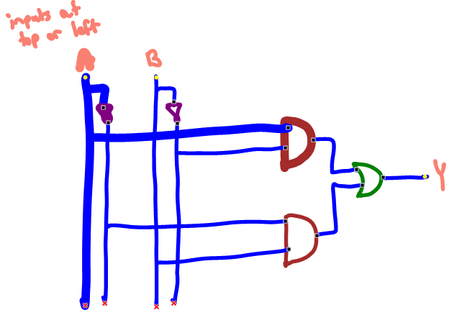
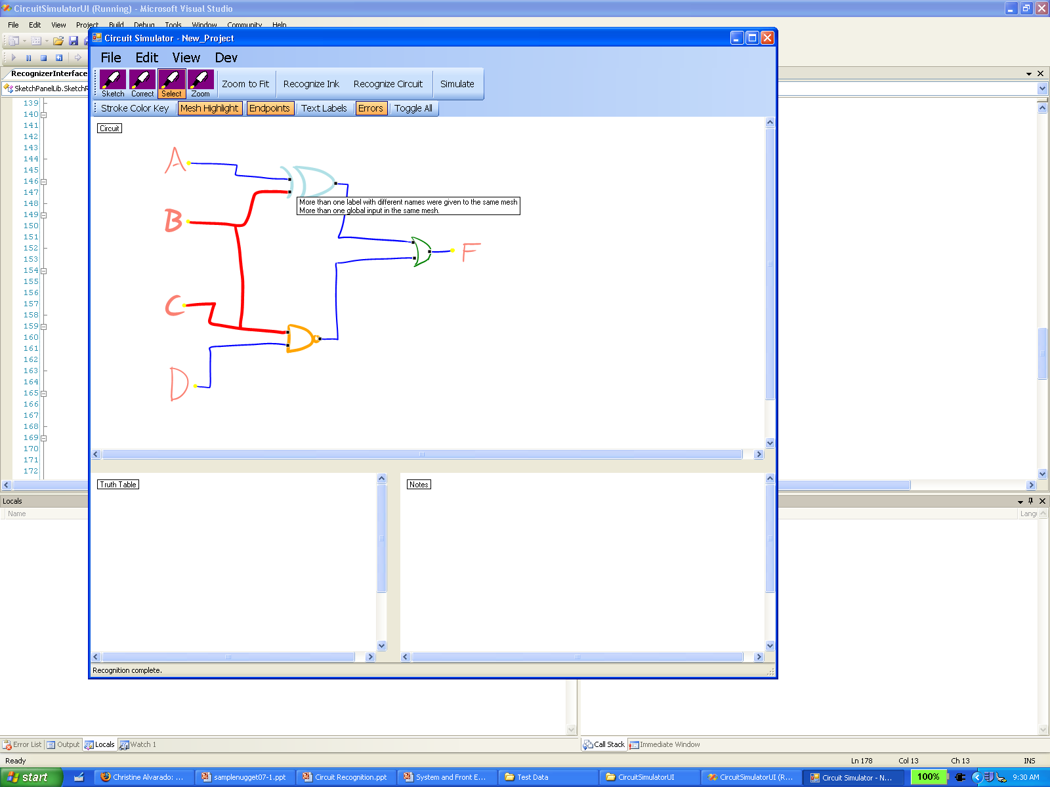
Circuit Parsing (cont.) 2) Connect endpoints to nearby gates. Use domain specific information to determine when the gates are completely connected. For example, AND gates have at least two inputs and only one output. 3) Connect wires to other wires by looking to see if an unconnected endpoint is close to another wire. 4) Associate signal labels with the nearest wire. 5) Assign a global polarity (input, output, or internal) to each wire based on a set of heuristics and a neural network. This completes the connection information.
User Feedback. Connection information is structured to support mesh highlighting. If the user hovers the stylus over a wire, it will highlight the gates that it is attached to, as well as any label it is associated with. Wire endpoints are displayed, showing their location and their connection status.
Results. Over 61 user sketches, the endpoint algorithm had an accuracy of 93.5%. Of the 42 sketches that had no endpoint errors, the gate and wire connection algorithm had an accuracy of 98.0%, and over nine sketches that were not used to train the neural network, the polarity assignment was 100% accurate, even in the presence of endpoint and connection errors. For those nine sketches, 94.4% of the wires were identified correctly after all stages were complete.
Future Work. Earlier stages in recognition may include errors such as mislabeled or misgrouped strokes, so error correction algorithms must be added to increase accuracy.
Funding. Rose Hills Foundation.
X
X
X
X
Sample recognition results. Black dots show endpoints connected to gates, yellow dots show association with a label, and red X’s indicate no connection. Top: highlighting indicates that the wire has the signal name A and is connected to two gates. Bottom: errors are highlighted in red with an accompanying error message.

